Slide 1

`

Slide 2
Welcome:
Imperial
Kern
Riverside
San Bernardino

Slide 3
Mission:
Our collaboration mission is to work together to ensure we are meeting the needs of our community.

Slide 4

Introduction to:

Slide 5
How we Open Cases:
        Service referral from Dept. of Social Services for dependent(s) who are receiving Cal-works.
        Dependent(s) are in foster care.
        Receive an application for services from the Person Receiving Support (PRS) or Person Paying Support (PPS).
        Referral from another child support agency
          (State or International Jurisdiction)

Slide 6
Local Child Support Agency (LCSA) Services:
Services offered
Locate
Establish Paternity
Establishment of an order
Enforce court orders:
  Child Support, Spousal Support, Health Insurance & Uninsured Court Ordered Medical Reimbursed Costs
  Modification of child support court order
Enforce and collect on arrears only cases

Slide 7
Local Child Support Agency (LCSA) Services:
Services Not Offered
Divorce
Custody
Visitation
Restraining Orders
Establish spousal support orders

Slide 8
Withholding Priority:
      Current Child/Family Support
      Medical Support
      Current Spousal Support
      Child/Family Support Arrears
      Spousal Support Arears
  Note: Current support ALWAYS takes priority over other deductions

Slide 9

Confidentiality:
    Child Support case records are confidential
    Case Worker can ONLY discuss a case as it relates to the employer’s ability and/or obligation to process the order.

Slide 10
What’s the difference?:
From a Local Child Support Agency (LCSA): Cases managed by child support agencies in any state are called “IV-D” cases, referring to Title IV-D of the Federal Social Security Act, the law that created Child Support Services agencies.
  Income Withholding Orders are issued by the child support agency administratively and do not require a judge’s signature. (CCP§706.0301b)
Private Cases: If the case is not being managed through a child support agency, the family court will issue the Income Withholding Order. This is called a non “IV-D” case or Private Case.
  You the employer will be served with the documentation by a private party, i.e., by either the person who will be receiving the support or that person’s representative.

Slide 11
Employer Responsibilities:
Private Orders (Non IV-D) do not originate from the LCSA, the California State Disbursement Unit (SDU), which processes all child support payments, may need additional information to ensure the payment is processed accurately. This may include employee’s social security or court case number.
Employers may receive an Income Withholding Order by a California local child support agency, by another state’s child support agency, or by a private party

Slide 12
How Employers Help their Communities by Complying with
Child Support Withholding:
      Deducting for child and medical support obligations
      Enrolling dependents’ children in health insurance and increasing access to preventive health.
      Saving taxpayers’ dollars
      Preventing and reducing fraud
      Promoting a stable and reliable workforce
      Encouraging a future skilled workforce
      Improving financial stability for families
Notes:
By deducting for child and medical support obligations – More than 70% of child support collections sent to families come from income withholding.
By saving taxpayers’ dollars – Child support collections reimburse public assistance spending and reduce government spending by increasing child support collections for families who would otherwise by forced to seek public assistance.
By preventing and reducing fraud – State agencies use new hire employment information to reduce overpayments in areas of public assistance, unemployment insurance, disability insurance, and workers compensation benefits.
By promoting a stable and reliable workforce – Employees whose children are provided consistent support will face less stress and be better able to focus on their jobs.
By encouraging a future skilled workforce – Providing financial stability through child support contributes to the education and training of a new generation of workers.

Slide 13

As employers, you are one of our closest partners, with an important role in helping ensure families get the financial and medical support they need.
More than 66% of all child support collections are through payroll deductions.
More money for the family..
Notes:
https://www.acf.hhs.gov/css/resource/2018-infographic-more-money-for-families
NOTE: in non-aid case, the family sets 100% of the collectors

Slide 14
Kern County
Monday-Friday: 8:00 am to 5:00 pm
Bakersfield:
3701 N. Sillect Avenue, Bakersfield, CA 93308
Ridgecrest:
400 N. China Lake Blvd., Ridgecrest, CA 93555
Delano:
455 Lexington Street, Delano CA 93215
https://kerncountychildsupportservices.com

Slide 15
Riverside County
Monday-Friday: 8:30 am to 5:30 pm
Blythe:
260 N. Broadway, Blythe CA 92225
Indio:
47-950 Arabia Street, Indio, CA 92201
Riverside:
2041 Iowa Avenue, Riverside, CA 92507
http://riversidechildsupport.com

Slide 16
  Imperial County
  Monday-Friday, 7:30 AM to 4:30 PM
  2795 S 4th. Street El Centro, CA 92243
  https://css.imperialcounty.org/

Slide 17
San Bernardino County
Monday-Friday: 8:00 am to 5:00 pm
Loma Linda:
10417 Mountain View Ave. Loma Linda, CA 92354
Ontario:
191 N. Vineyard Ave. Ontario, CA 91764
Victorville:
15400 Civic Drive, Victorville, CA 92392
http://wp.sbcounty.gov/dcss/

Slide 18


Slide 19

Income Withholding Requirements:

Slide 20
Income Withholding Order (IWO):
  The Income Withholding Order (IWO) is a court order served on employers that requires them to withhold a specified amount of an employee’s wages for payment of child and medical support.
  It may also be referred to as a wage assignment, garnishment order, or an income withholding for support order.
  Employers may be served with an Income Withholding Order by a local child support agency (LCSA), by private party, or by another state’s child support agency.
  Income withholding is the most effective method of child support collection. In California, wage withholding accounts for more than 66 percent of child support collected.

Slide 21
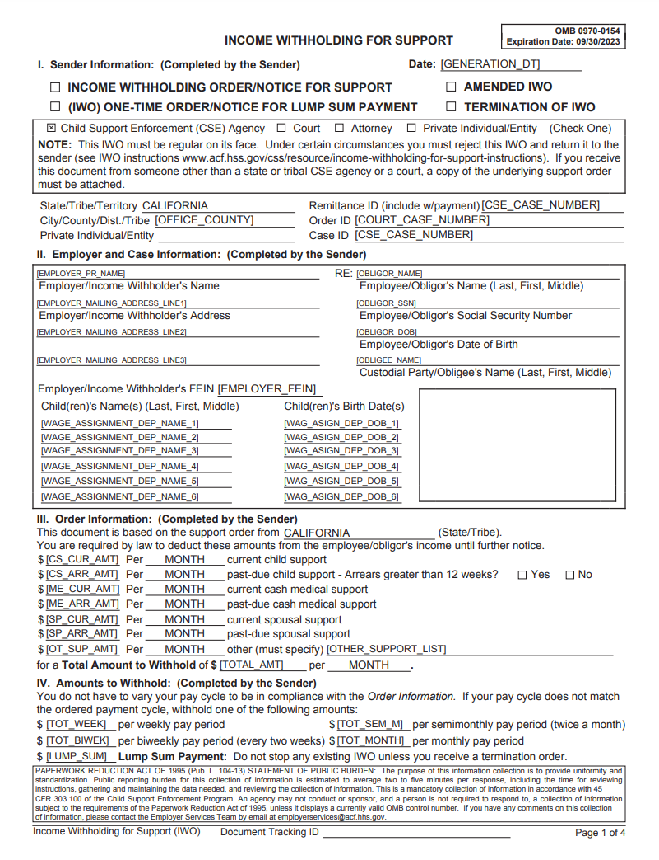
Obligations of DCSS:
Income Withholding Order (IWO)
  Obtained in every case with a support order
  Served on Employer within 15 days from entry of support order
  OR
  When employee changes employment and new employer’s address is obtained

Slide 22
Income Withholding Order:
  Effective and binding upon any existing or future employer of the Person Paying Support (PPS).
  May be transferred by electronic means
  Issued by another state’s court or administrative agency is as binding on an employer as an order made by a California court
(FC§5700.502)

Slide 23
Out-of-State Orders:
  Comply with an out-of-state IWO as if it is a California order (FC 5700.502)
  Failure to comply = same penalties below (FC 5700.505)
  As long as you are complying with the IWO, employer has immunity from civil liability (FC 5700.504)
  To contest, the obligor has to register in this state and challenge in court (FC 5700.506)

Slide 24
Compliance Timeframes:
Within 10 days of receiving an IWO, the employer will need to notify the employee and provide the employee with:
  Copy of the IWO- Order of Notice
  Request for hearing regarding earning assignment.
  Copy of the statement of the employee’s rights to quash, modify, or stay service of the order.
  Blank form with instructions for the employee to file for relief within 10 calendar days after service of the IWO.
CCP§706.030(b)(3)

Slide 25
Compliance Timeframes:
    The employer should:
      Begin withholding the support amount no later than first pay period after 10 days after receiving the Income Withholding Order. (CCP§706.022)
      Deduct support amount from the employee’s net disposable income (NDI)
      Deduction is not to exceed 50% of NDI (CCP§706.052i 15 USC 1673)
        Even if the support order does

Slide 26
Compliance Timeframes:
  The employer must remit the payment to the State Disbursement Unit (CCP§706.030 (c)(6))
  No later then 10 days after close of pay period. (CCP§706.025)
  Until served with a notice modifying amount to be withheld or terminating the order
CCP §706.027

Slide 27
Employer Responsibilities:
    Provide relevant employment and income information:
      Verification of employment
      Full name of employee
      Last known residence address of employee
      Date of birth
      Social Security Number
      Dates of employment
      Past and present earnings
      Availability of health insurance coverage
    FC §3767 & 3771

Slide 28
Employer Responsibilities:
    Wage and Insurance Verification Form (DCSS-0230)
          Requests information concerning the employee
          Signed under penalty of perjury by employer
          Used as evidence in court
          Avoids the need for a subpoena
    Employee Status Report (DCSS-0522, similar to Page 4 of Income Withholding)
          Inform Child Support on/before the next payment due date of:
          New employer’s address (if known) or employment status
          Employee’s last known residence address
          Employee’s last known telephone number

Slide 29
Employer Responsibilities:
Employers SHALL NOT do the following based on the existence of an IWO:
    Refuse to hire
    Discriminate
    Discipline
    Terminate
    Labor Code §2929(b) and Family Code §3769
Notes:
Review to try to soften this slide

Slide 30
Orders/Liens - Priority of Withholding:
        Child Support order
        Bankruptcy order
        Federal Administrative Garnishment
        Federal Tax Levy*
        Student Loan
        State Tax Levy
        Local Tax Levy
        Creditor Garnishment
        Employer deductions
FC§5238 – Priority of pays: Child Support, Spousal Support, Health Insurance, Arrears
*Levy received prior to Child Support order have priority.
      FC§4011- Child support gets paid before all other creditors.

Slide 31

Applying Withholding:
    Current Child/Family Support
    Medical Support, if on IWO
    Current Spousal Support
    Child/Family Support Arrears
    Spousal Support Arrears

Slide 32
Remitting Payments:
Provide the following information for each employee:
    Name as it appears on the Notice to Withhold
    Social Security Number
    Legal date of collection
    Case or court order number
    Payments for multiple employees may be combined into one check, but you must provide an itemized accounting for each employee.

Slide 33

Calculating: Net Disposable Income (NDI)
  NDI= Gross earnings less ONLY:
          Mandatory deductions
          State and federal taxes, SDI, etc.
          Mandatory union dues
          Mandatory retirement
            Does not include 401K
            Does not include other voluntary deductions such as advances

Slide 34
WHAT ARE EARNINGS:
Family Code Section 5206 defines Earnings as:
Payments to Independent Contractor services. (FC§5206(b))
Salary
Residuals
Retirement
Vacation Pay
Bonuses
Dividends
Royalties
Commissions
Notes:
Note: Basically anything someone gets as remuneration.

Slide 35
Penalties for Non-Compliance:
  Employers who fail to withhold and forward support is liable to:
    The Child Support Agency for the amount of support not withheld, forwarded or paid, including interest
    Employee for amounts withheld and not forwarded
    Failure to comply is punishable by contempt
    Employer can be sued for conversion (i.e. theft)
    Employer can be charged criminally for theft or embezzlement.

Slide 36
Electronic Fund Transfer:
DCSS may seek an order requiring payment of support by electronic transfer from the employer’s bank account if the employer willfully:
  Fails to comply with the Notice to Withhold.
  Fails to comply on 3 separate occasions within a 12-month period.
  Civil penalties can be up to 50% of the support amount
FC§5241

Slide 37
Employer Questions:
  DCSS cannot answer the following:
        Why is the order so high?
        How do you expect this person to live?
        Can we work out a better payment plan?

Slide 38
  Confidentiality:
  DCSS case records are confidential
  Employers can only be given information to comply with the IWO
  DCSS can only discuss case as it relates to the employer’s ability and/or obligation to process the IWO
  Encourage the employee to contact DCSS directly.

Slide 39


Slide 40


Electronic Income Withholding Order (e-IWO)
Angela Jones
Employer Outreach Coordinator, California Child Support Services

Slide 41

What is e-IWO?
  Receive Income Withholding Orders (IWO) electronically
  Notify child support agencies of terminations and
lump sums
  Acknowledge acceptance or rejection of IWOs
“A paperless solution”

Slide 42
  Child support gets to the family sooner
  Saves time, money and resources
  Ensures uniform IWO data from all states
  Increases accuracy and reliability of data
  No cost to employers

Slide 43


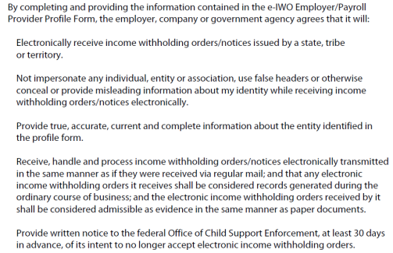

Registration for
e-IWO:
Complete a profile form and FEIN spreadsheet
The Registration includes an agreement to process e-IWOs.

Slide 44
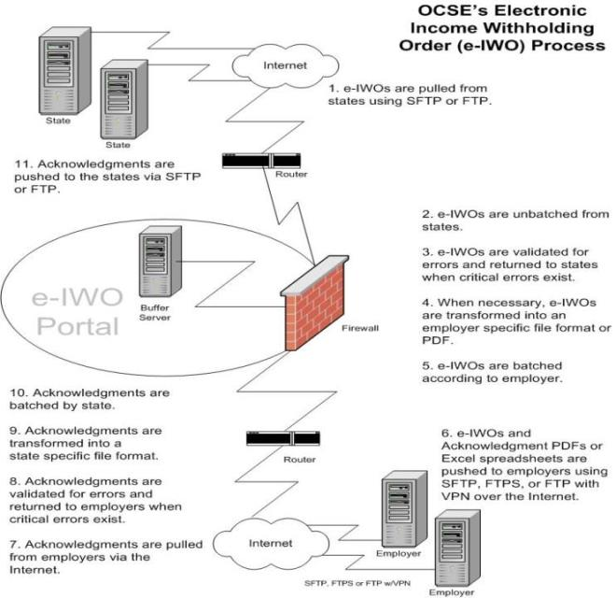
e-IWO Process:

Slide 45
Two options to implement:
  System-to-System interface (High volume IWO)
    Requires IT resources for programing
  No Programming option (Low volume IWO)
  PDF copy of IWO is provided
  Easy to Implement
  Minimal IT investment
  Ability to accept or reject IWOs
  Handles terminations and lump sum reporting

Slide 46
System-To-System Implementation:
For employers with large volume of IWOs
Flat file or XML schema offered
Mapping required
IWOs received in file/batches
Image-ready IWO PDF available
Employer generates Acknowledgement
Manual processing minimized
Estimate 3-5 months of IT resources

Slide 47
No Programming Options:
Option 1
  Receive PDF Income Withholding Order
  Send PDF Acknowledgement
  600+ employers using PDF Acknowledgement
Option 2
  Receive PDF Income Withholding Order
  Send Excel spreadsheet Acknowledgement
  170+ employers using Excel (XLS) Acknowledgement

Slide 48
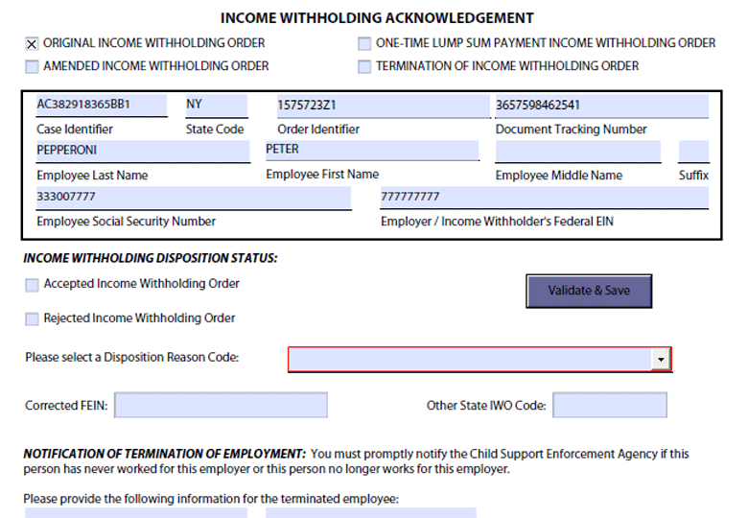
Sample PDF Acknowledgement:
Select Accept or Reject
Click
Validate and Save
You’re Done!

Slide 49
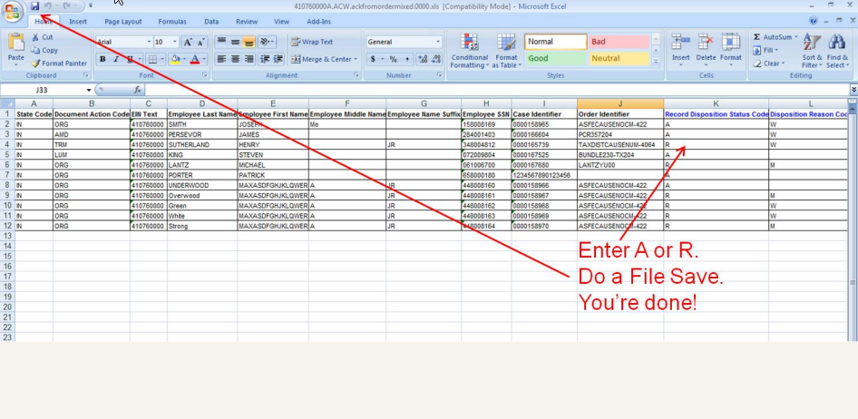
Sample Excel (XLS) Acknowledgement:

Slide 50
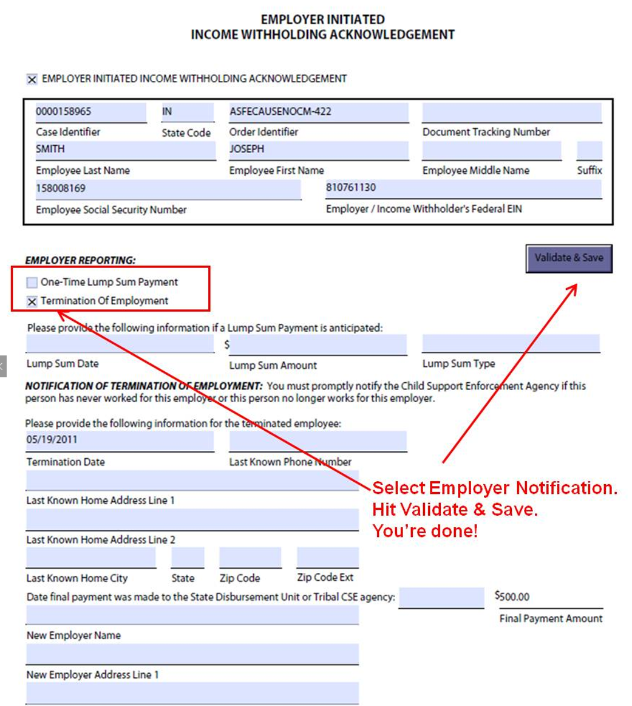
Employer Initiated
Acknowledgement:

Slide 51
Sample Daily Process Email Notifications:
Processing Summary
  Total # of records received: 28
  Total # of error records: 1
  Total # of records forwarded: 27
  Total # of files rejected: 0
  Total # of batches received: 11
File Sent to the Employer
  IWO Details: 18
  Acknowledgements: 0
  PDF Orders: 18
  PDF Acknowledgements: 0
  XLS Acknowledgements: 0
  Error: 0
  Reject: 0

Slide 52
Preparing for the e-IWO:
Employers Need
  Secure File Transfer Protocol (SFTP) Server or
  FTP Server with a Virtual Private Network (VPN) or
  File Transfer Protocol Server (FTPS)
  Adobe Reader v. 10 or higher with JavaScript for fillable PDF
Next Steps
  Fill out profile form and FEIN spreadsheet (if applicable)
  Set up connectivity (We will help you!)
  Conduct a test
  Start receiving IWOs electronically

Slide 53
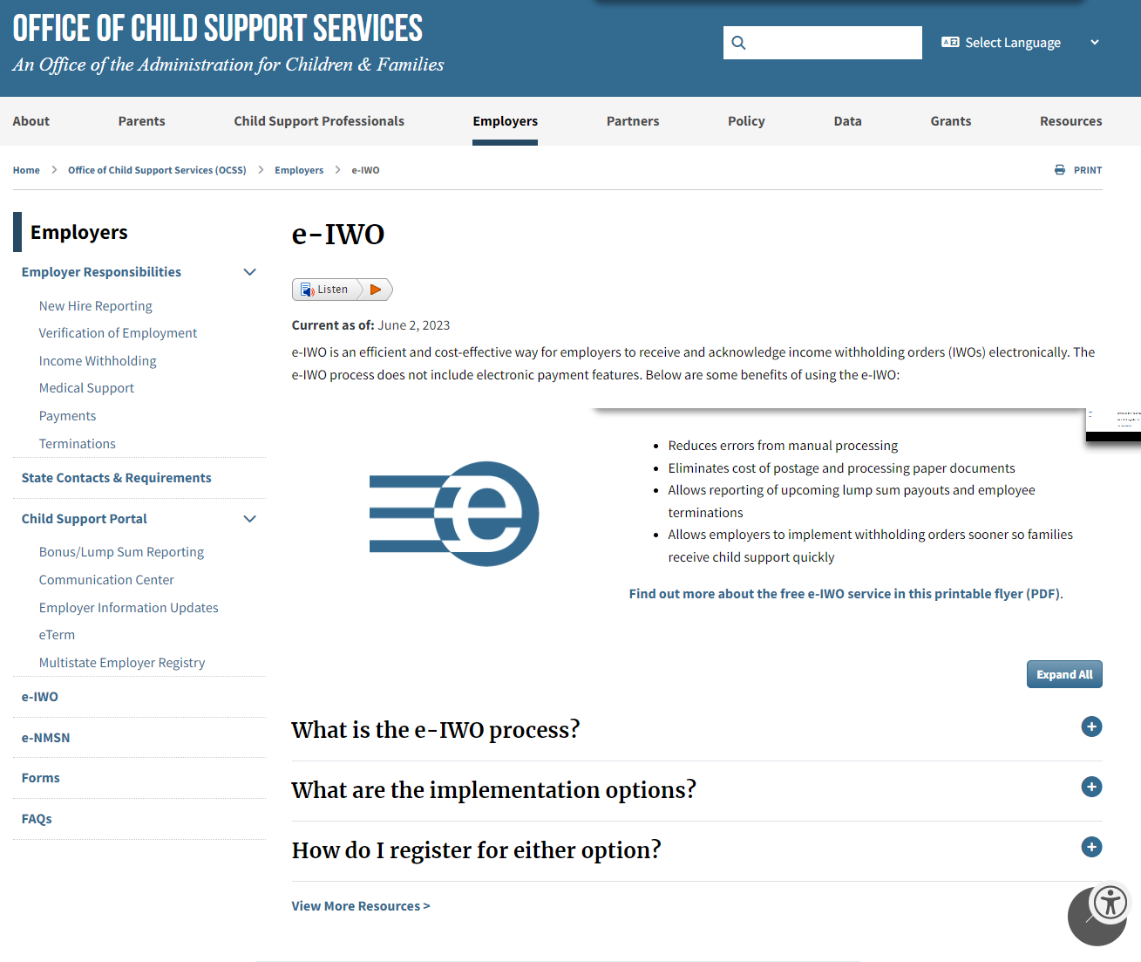
e-IWO Resources:
Visit:
acf.hhs.gov/css/employers/e-iwo
To get started, contact: eiwomail@acf.hhs.gov

Slide 54


Slide 55

Bonus or Lump Sum
Income Withholding Order:

Slide 56
What is a lump sum payment?
  A bonus/lump sum payment made to an employee is considered income and can be garnished to collect past due child support (arrears).
  One-time payment made to an employee from their vacation payouts, cash awards or bonuses.

Slide 57

What is considered a bonus or lump sum payment?
    Severance
    Vacation payouts
    Insurance settlements
    Retirement incentives
    Stock options
    Lottery winnings
    Awards
    Payments from verdicts
    Workers compensation
    Retroactive pay increases
    Sign on bonus
    Commission

Slide 58
All employers served with an Income Withholding Order are required by California (FC) section 17512 to comply.
Report all earnings as defined by FC section 5206.
This means employers are required to report bonus/lump sum income

Slide 59
Reporting Bonuses and Lump Sum:
Employers are encouraged to report any bonus or lump sum payment prior to payout by contacting California Child Support Services: fax, email, e-IWO, or USPS.
  Report by Phone or Email
    Prior to payout by contacting California Child Support Services at lumpsumresponseteam@dcss.ca.gov or 916-464-6640.
  Federal Office of Child Support Services (OCSS) website. www.acf.hhs.gov/css/employers/child-support-portal/bonus-lump-sum-reporting
  The maximum withholding is 50% of the net disposable earning under
      CA Code of Civil Procedure Section 706.052(a)
  Note: Payments to an independent contractor are subject to the maximum 50% net disposable earnings withholding limit. (FC§5206)

Slide 60
Ways to Enroll:
Federal Office of Child Support Services:
http://www.acf.hhs.gov/programs/css/employers/e-IWO
    Reporting Lump Sum Resources:
    https://www.acf.hhs.gov/css/outreach-material/report-lump-sum-payments-online#signup
    Child Support Portal:
    https://ocsp.acf.hhs.gov/csp/home/ocse

Slide 61
Where would I find the State’s reporting requirements?
  Employers may find more information about each state’s requirements on the
  State Lump Sum Requirements:
  Employers can quickly report upcoming lump sum payments to employees using the online bonus/lump sum application on the Child Support Portal
  https://www.acf.hhs.gov/css/contact-information/state-lump-sum-contacts-and-program-requirements

Slide 62
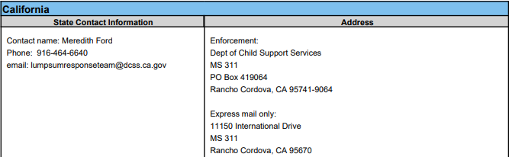
Office of Child Support Enforcement:
Website:
https://www.acf.hhs.gov/css/resource/bonus-lump-sum-answers-to-employers-questions

Slide 63


Slide 64

National Medical Support Notice
(N.M.S.N.):

Slide 65

What is Medical Support?
  Form of child support that requires one or both parents to provide health care coverage under a parent's policy or cash medical support.
    Provide health insurance if available through an employer.
    Pay premiums for private health care coverage or reimburse a parent for all or a portion of the costs of health insurance
    Court ordered dependent health insurance coverage.
    Pay additional amounts to cover a portion of ongoing medical bills or as reimbursement for uninsured medical costs.

Slide 66

What Constitutes as Health Insurance?
                Medical
                Dental
                Vision
                Mental Health
                Prescription Drugs
  Can be a combined or separate policies or plans.

Slide 67
Legal Obligations:
  State laws require that health care coverage be provided under a medical support order even if the child:
          Born to unmarried parents.
          Is not claimed as a dependent for tax purposes.
          Does not reside with the parent or in the insurer's service area.
Notes:
All Local Child Support Agencies (LCSA) in California are required to include provisions for health care coverage in their child support guidelines, and the child support agency is required to pursue private health care coverage when such coverage is available through a noncustodial parent's employer at a reasonable cost.
Current law requires that every child support order, enforced by a child support agency, include a provision for health care coverage.

Slide 68
Enrollment:
  Group Health Insurance Plan(s) is required:
  If your company maintains or contributes to plans providing dependent or family health care coverage
  If your employee is among a class of employees that is eligible for family health coverage after the waiting/probationary period has been satisfied
  If coverage is available at a reasonable cost

Slide 69

  Legislation Update
    California Laws: Reasonable Cost and Accessibility
  Cost is presumed reasonable in California if the difference between self-only and family coverage does not exceed 5% of the employee’s gross income. (FC§3751(b))
    Reasonable cost will be determined by the LCSA
  Health insurance is presumed to be accessible if:
    Services can be provided within 50 miles of the supported dependent(s) residence. (FC§4063(s)(1))
Notes:
Use some examples

Slide 70
Reasonable Cost:
The burden of proof is on the employee to dispute reasonable cost.
The LCSA will use the following equation to calculate reasonable cost
  (Cost of Family Coverage) – (Self-Only) = (5% or less of NP’s gross income)
For example: Family coverage is $500.00 per month and self-only coverage is $300.00 per month; the difference of $200.00 cannot exceed 5% of the NP’s gross income.
NOTE:
The employer must still comply with the NMSN regardless of whether an objection has been made or not until a determination has been made
States determine what is a reasonable cost for medical insurance, and employers can find that information on the Medical Support Requirements matrix.
        California Family Code (FC) Sections 3750-3753. Pursuant to FC Section 3751(a)(2)

Slide 71
Employer Responsibilities:
  Employer shall:
Allow the employee to enroll their dependent(s) without regard to open enrollment restrictions.
Deduct cost of H/I coverage in addition to the child support amount
Provide coverage to the employees’ children even if the employee declines his/her own personal health coverage.
Provide the LCSA within 30 days:
    Employee’s SSN and home address
    Name of insurance company, policy number and names of person covered
Notify LCSA when there is a lapse in coverage
    Date coverage ended
    Reason for lapse
    When coverage is expected to resume
Notes:
Presenter can you please shorten the wording on these?

Slide 72
Employer Responsibilities:
  Should Refrain from:
    Deny enrollment because the child:
      Was Not claimed as a dependent on the employee's tax return
      Does not reside with the employee
      Does not live within the service area
      born out of wedlock
    Refuse to hire
    Discriminate
    Terminate coverage for a child unless:
      H/I coverage has been eliminated for all employees
      Receive evidence that the order has terminated (from the LCSA/courts)

Slide 73
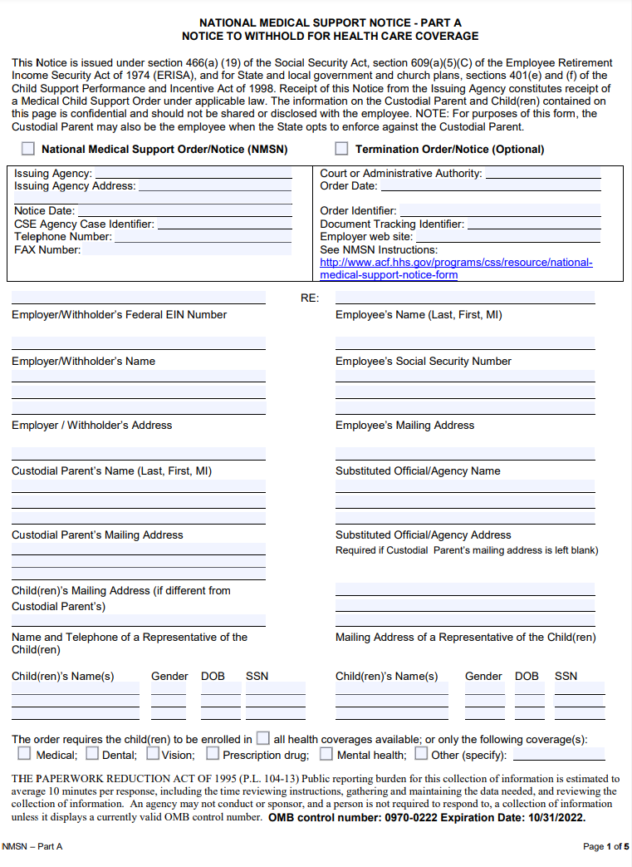
National Medical
Support Notice:
Part A:
Notice to Withhold for Health Care Coverage

Slide 74
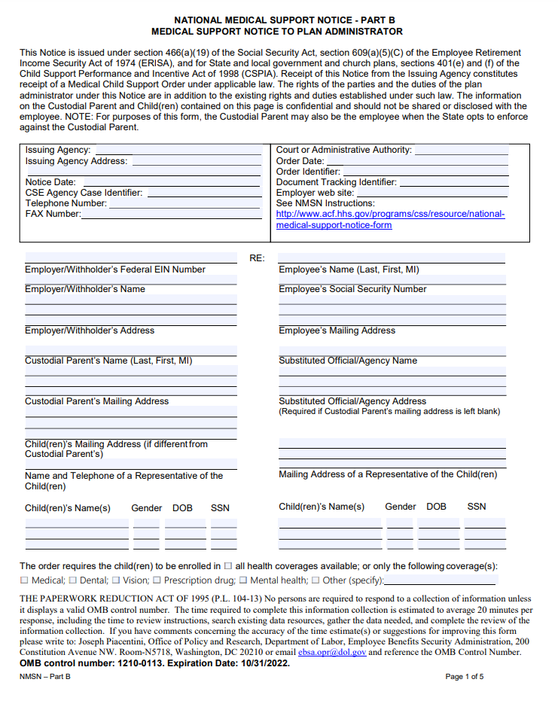
National Medical
Support Notice:
Part B:
Medical Support Notice to Plan Administrator

Slide 75
NMSN Time Frames:
    Within 10 business days:
          Employer must notify the employee and provide him/her with the following 4 forms:
          Copy of NMSN Part A (OMB 0970-0222)
          Statement of Obligor’s Rights and Procedures Regarding NMSN (DCSS 0361)
          Information Sheet (FL-478 INFO)
          Request and Notice of Hearing (FL-478)
    Within 20 business days:
          Employer must notify the employee and provide him/her with the following 4 forms:
          Copy of NMSN Part A (OMB 0970-0222)
          Statement of Obligor’s Rights and Procedures Regarding NMSN (DCSS 0361)
          Information Sheet (FL-478 INFO)
          Request and Notice of Hearing (FL-478)
          Employer must enroll the employee’s children to a health care plan and return the Health Insurance Information (From DCSS 0054) the LCSA.
      https://dcss.ca.gov/wp-content/uploads/sites/345/2022/12/HealthInsuranceInformation_12122022.pdf

Slide 76
NMSN Time Frames:
    Within 40 business days:
      Employer must provide the LCSA with description of the coverage available and of any forms required to activate coverage.
        Termination/Lapse In Coverage
    Within 10 business days:
      Employer must notify the LCSA office any lapse of coverage.
    Within 20 business days:
      Notify the LCSA of termination of benefits or termination of employment.
    Return the Termination of Benefits/Employment Notice (DCSS 0114)
    https://dcss.ca.gov/wp-content/uploads/sites/345/2022/12/TerminationofBenefits_08192019.pdf

Slide 77
Points to Consider:
    When the employee's dependent(s) have been enrolled in your group health insurance plan, the LCSA is required to notify the Custodial Party in writing.
    LCSA will provide the Custodial Parent the dependent’s health insurance cards once received from the employer.
        If the insurance cards are not immediately available, please provide them to our office when received. The information you provide makes a huge difference in managing the health care for the dependent(s) you enroll.
    DCSS does not copy your forms and send it to the custodial party. Our office writes a letter to the custodial party providing him/her with the information you provide.

Slide 78

Penalty for Non-Compliance:
  Failure to comply is punishable by contempt
  An employer who willfully fails to comply with the NMSN is liable to the custodial party for the amount incurred in health care cost.

Slide 79

Contact:
California Program and Policy Branch
Phone: 916-464-5883
Fax: 916-464-5893
E-mail: policy.branch@dcss.ca.gov
The employer forms you will need are located at: https://www.acf.hhs.gov/css/resource/national-medical-support-notice-form

Slide 80


Slide 81

Reporting New Hires and
Independent Contractors to the
Employment Development Department (EDD):

Slide 82
New Hire Reporting Requirements:
    Report New Hires and Rehires within 20 days of their start-of-work-date to the Employment Development Department.
      Rehired employees are those that have separated for at least 60 consecutive days and return to your employment.
    Report Independent Contractors within 20 days of
    contracting if any of the following apply:
      Form 1099 for services provided
      $600 or more paid
      Enter into a contract for $600 or more
Notes:
Although EDD is a separate agency from the Department of Child Support Services, information about newly hired and rehired employees is used to obtain support for children.

Slide 83
Why Is This Important?
    To assist in locating parents who owe support.
    Increases child support collections.
    Reduces welfare costs
    Reduces Medi-Cal costs.
    New Hire Reporting helps the child support program
      Locate parents
      Establish wage withholding orders
      Enforce existing orders
    The information is also sent to the National Directory of New Hires to locate delinquent debtors in other states.
Note: Nearly 30 percent of child support cases involve parents who do not live in the same state as their children.

Slide 84
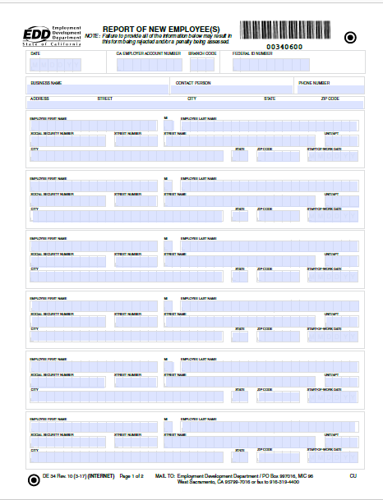
Reporting New/Rehire Employee(s):
  Form DE 34
Document Management Group
P.O Box 997016, MIC 96
West Sacramento, CA 95799-7016
FAX: (916) 319-4400
  e-Services for Business
  Fast, Easy and Secure
  edd.ca.gov/en/Payroll_Taxes/e-Services_for_Business

Slide 85
Independent Contractor Reporting Requirements:
Service-provider
(Independent Contractor):
First name, middle initial, and last name
Social Security number
Address
Start date of contract (if no contract, date payments equal $600 or more).
Amount of contract, including cents (if applicable)
Contract expiration date (if applicable)
Ongoing contract (check box if applicable)
Service-recipient
(Business or Government entity):
Federal Employer Identification Number (FEIN)
California employer payroll tax account number (if applicable)
Social Security number (SSN)
Service-recipient name/business name, address, and phone number

Slide 86
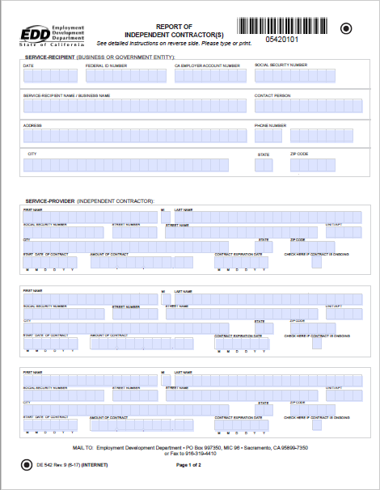
Reporting
Independent Contractors:
Form DE 542
Document Management Group
P.O. Box 997350 MIC 96
West Sacramento, CA 95899-7350
Fax: (916) 319-4410
  e-Services for Business
  Fast, Easy and Secure
  edd.ca.gov/en/Payroll_Taxes/e-Services_for_Business

Slide 87

Need Assistance Reporting:
    New Hire and Independent Contractors
    Taxpayer Assistance Center
    Monday-Friday 8am-5pm
    (888) 745-3886

Slide 88


Slide 89

Updating Employer Information:

Slide 90

How to Stay Connected with California Child Support Services:
    Do you need to update your phone or fax number?
    Has the company changed their name?
    Has the payroll contact person changed?
    Do you need to update the health insurance information?
    Has the company moved and there is a new address?

Slide 91
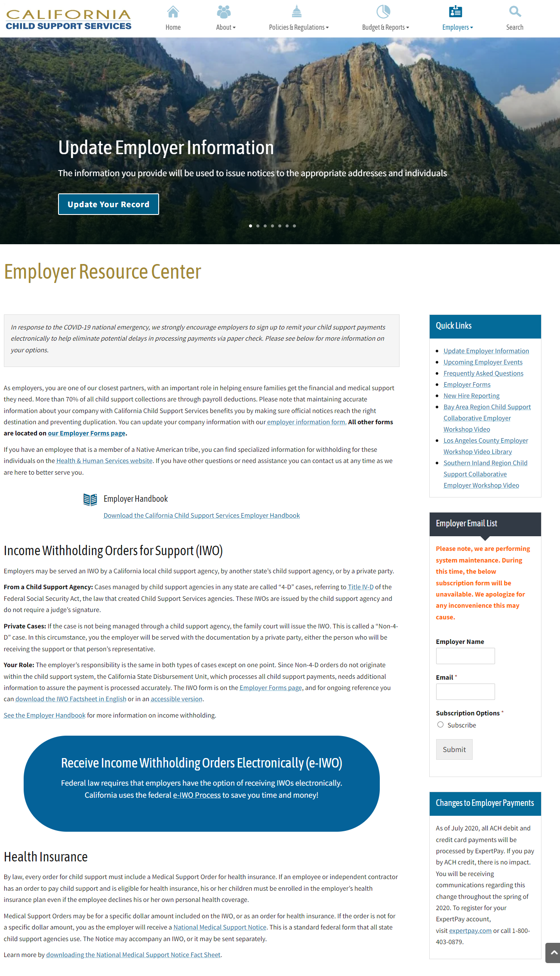
Employer Resource
Center:
dcss.ca.gov/employer-resource/

Slide 92
Update Employer Information:

Slide 93
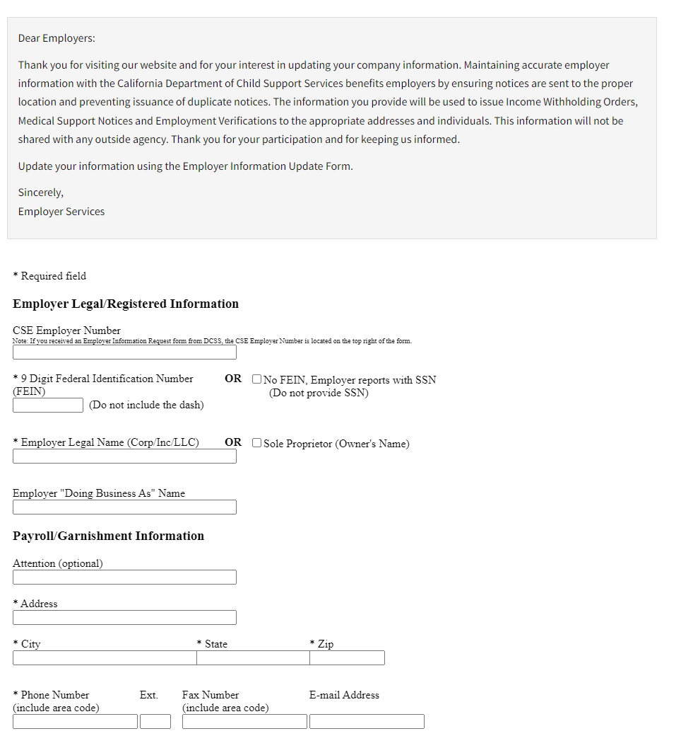
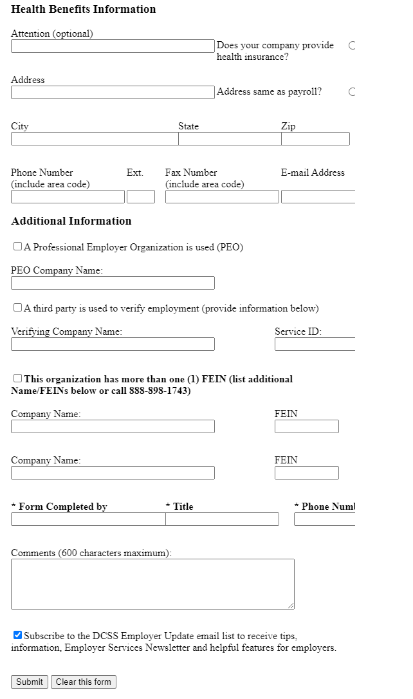
Update Employer Contact Information:

Slide 94
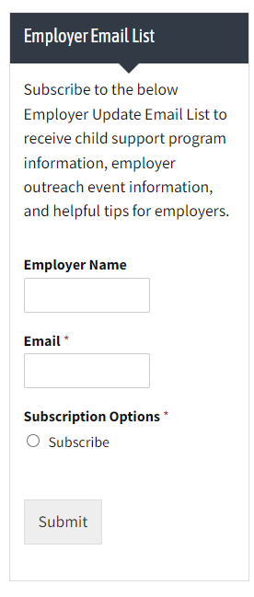
Stay Connected:
Notes:
To register as an Employer and make payments for your employees.
Note: Your FEIN will be needed to register once.
Register
Upon successful registration, a temporary password will be sent to the email address you provided.
Once you receive and login with your temporary password, you will be directed to the Change Password page.

Slide 95

Employer Events:
Notes:
To register as an Employer and make payments for your employees.
Note: Your FEIN will be needed to register once.
Register
Upon successful registration, a temporary password will be sent to the email address you provided.
Once you receive and login with your temporary password, you will be directed to the Change Password page.

Slide 96
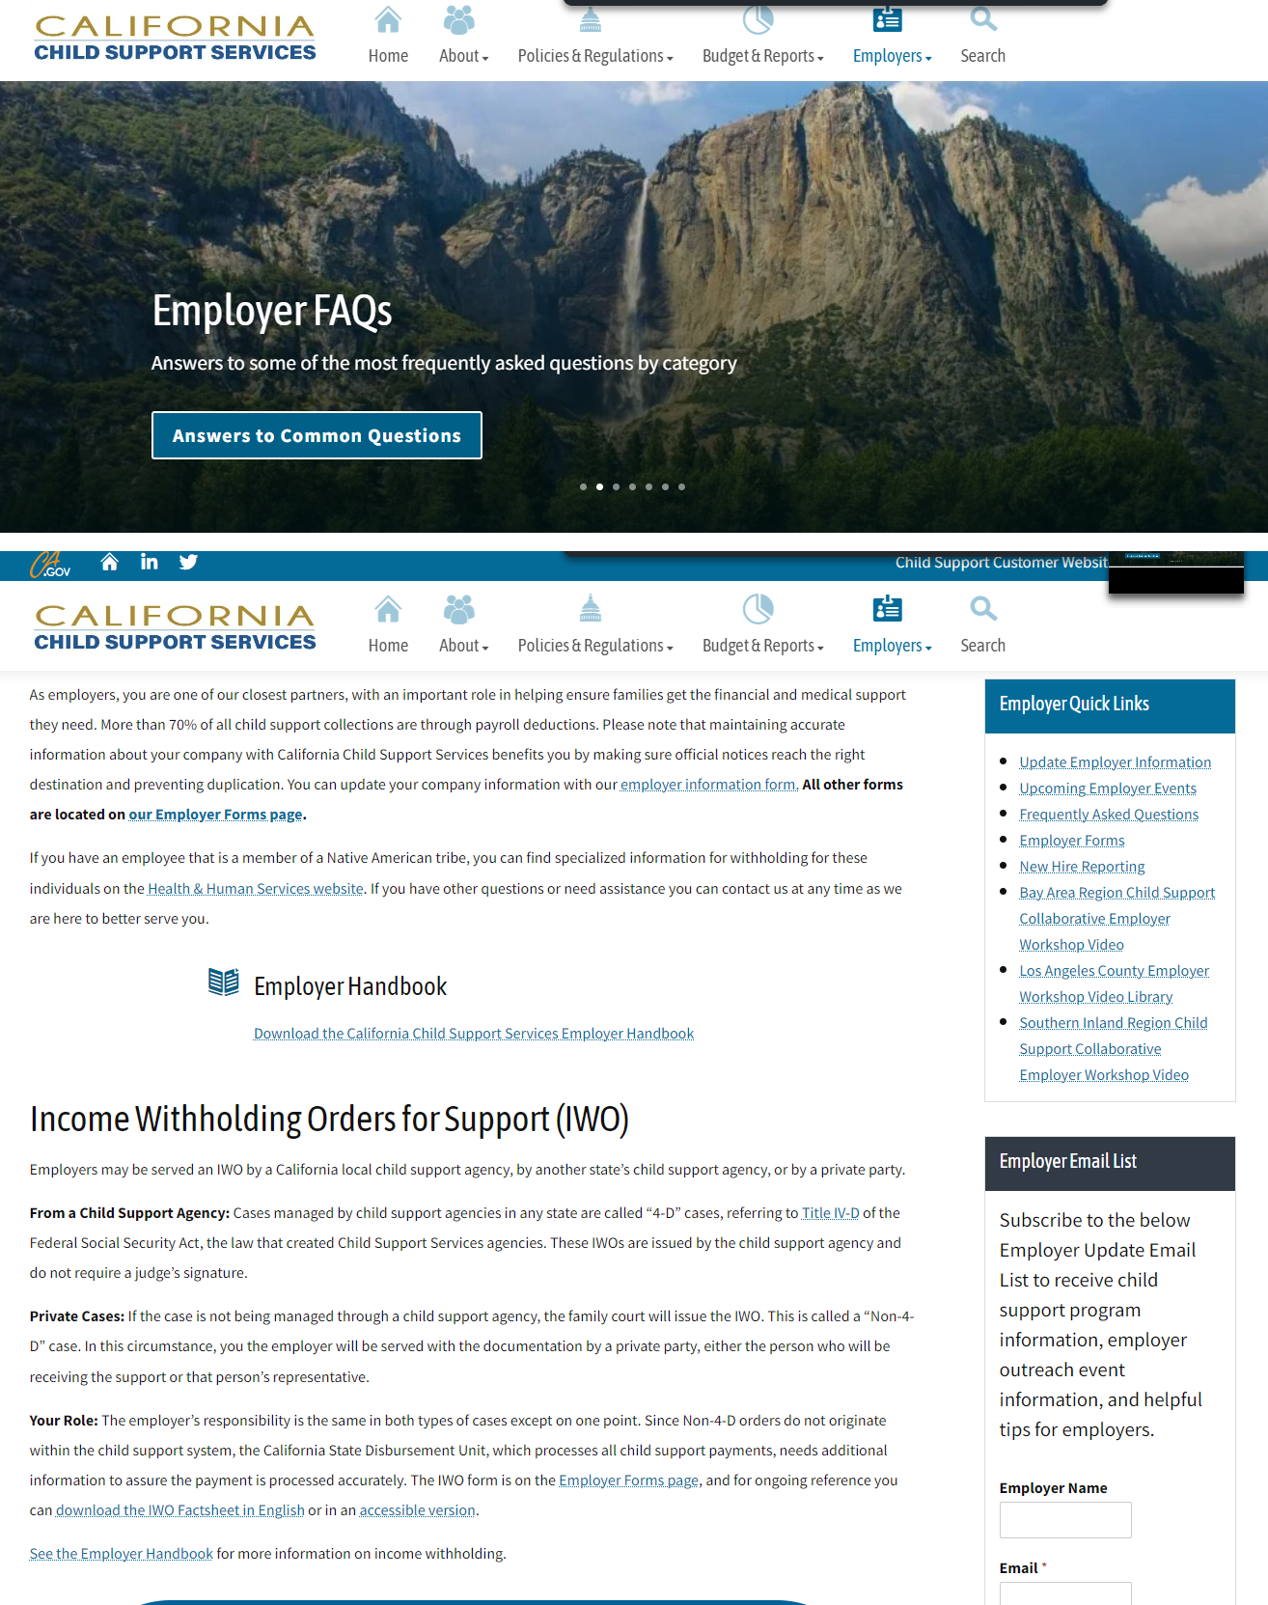
Employer FAQs:
Income Withholding Orders
e-IWO
SDU Payment Options
Reporting New Hires
Terminations
National Medical
Support Notice (NMSN)
Update Employer Information
Notes:
To register as an Employer and make payments for your employees.
Note: Your FEIN will be needed to register once.
Register
Upon successful registration, a temporary password will be sent to the email address you provided.
Once you receive and login with your temporary password, you will be directed to the Change Password page.

Slide 97
Employer Information & Contact Offices:
Employer Services Team 1-888-898-1743
State Contact Center 1-866-901-3212
Employer Contact List for Local Child Support Offices:
https://childsupport.ca.gov/find-my-local-agency/

Slide 98


Slide 99
State Disbursement Unit:

Slide 100
CA State Disbursement Unit (SDU) is a single payment processing center for employers to send child support wage withholding.
Reason for creation:
  Simplify the payment submission
  Improve accuracy of child support records
  Disburse speedy payment to the families
Federal law Requires:
  Every US State have one central location which processes all child support payments.
  Employers are required to direct all payments to the SDU.

Slide 101

CA SDU: State and County Functions
Centralized Payment Processing
Collections
Disbursements
Fund Allocations
Set-up Electronic Payments
Non IV-D Customer Service
ExpertPay for Employer

Slide 102
Employers:
    Remit all California child support payments to SDU
    Include necessary employee identification
          Employee name
          Social security number
          CSE participant number
          Amount
          Date of withholding
          Child Support Enforcement (CSE) case number

Slide 103
SDU Time Frames:
    Begin withholding with in 10 days.
    Send the amount withheld within 7 days.
    Notify the issuing LCSA in writing within 7 days if the employee is:
            No longer receiving payments from you
            Receiving disability
            On leave

Slide 104
Payment Options Explained:
  If an employer has more than one employee with a child support obligation, the payments may be combined into a single check.
    Include the following information for each employee:
            Employee name/Independent contractor name
            Child Support Enforcement (CSE) case number
            Employee’s Social Security Number
            Date money was withheld (pay date)
            The amount withheld for each employee
            Include a company contact name and phone number
  Employers who fail to withhold the amounts as specified on the IWO may be found liable for the full amount of the support owed, plus a fine.

Slide 105
Benefits of Electronic Payment Options:
Employers are encouraged to send payments electronically. These transactions are faster, more accurate and less expensive to process than paper checks.
If an employer pays taxes electronically to the Franchise Tax Board (FTB) or the Employment Development Department (EDD), then child support payments are required to be sent to the SDU using Electronic Funds Transfer (EFT).
Notes:
Pursuant to California Family Code §17309.5
Fewer errors
No lost checks
Saves time and money
Reduces risk of theft and fraud
Faster SDU collection receipt and processing
Green (eco-friendly)

Slide 106


Slide 107
Expert Pay Payment: (New Payment Portal )
Due to regulation changes from the National ACH Clearing House Association (NACHA), the State Disbursement Unit (SDU) is required to make changes to the SDU payment portal for payments made via a bank account.
The SDU’s current bank account payment option (ACH debit) will be going away and ACH debit payments will now be submitted through the ExpertPay platform.
Notes:
Changes went into effect January 2020 and will alter the way customers make payments via the SDU web page, Interactive Voice Response (IVR), ePayment Link (CSE link) and ePayment Call Center.
Registration fee is $2.50

Slide 108
ExpertPay:
Allows you (the employer) to ...
  Maintain employer data and facilitates the federally mandated payment of child support payments withheld from employees.
  Submit child support payments to the State Disbursement unit via the Internet.
  Save and maintain payment information for quick transactions.
  Create separate Payment Groups: If you have more than one facility in the state, you can create separate profiles for each facility, and if you registered more than one bank account, you can use different bank accounts for different profiles

Slide 109
ExpertPay Getting Started:
  In order to use ExpertPay, you will need to register and set-up your user id, your bank account information, and Payment Groups.
  Users will also be able to submit payments using their debit/credit card and PayPal account through the ExpertPay platform at cost to the remitter.
  The current process for using credit card via SDU website, IVR, ePayment Link (CSE link) and ePayment Call Center remains intact for customers at no cost.
  Details are on the ExpertPay website
  https://www.expertpay.com/employerapp/#/help

Slide 110
ACH Credit Payments:
Automated Clearing House (ACH) Credit
  Use your own payroll software to send Automated Clearing House credit payments (similar to direct deposit) utilizing CCD+ or CTX formats using the standard child support addendum segment.
  The CA SDU electronic help desk is here to help answer any questions by calling (866) 901-3212 (option 1) or email casdu-electronichelpdesk@dcss.ca.gov

Slide 111
Employer Payment Options:
        Online: https://childsupport.ca.gov/state-disbursement-unit/ Using debit, credit card or bank account information
                Phone: (866) 901-3212 (Option 1)
        Check mail to:
                State Disbursement Unit
                P.O Box 989067
                West Sacramento CA. 95798-1326
        ExpertPay: https://www.expertpay.com/
                customer.service@expertpay.com
                Phone: (800) 403-0879

Slide 112
Contact Information:
      California Child Support Services
      Website: dcss.ca.gov/
      Contact them between the hours of 6:00 am to 6:00 pm
      Phone: (866) 901-3212 (option 1)
      Fax: (888) 587-5471
      E-mail: casdu-electronichelpdesk@dcss.ca.gov
      Website: https://childsupport.ca.gov/state-disbursement-unit/
      Mail Address: PO Box 981326 West Sacramento, CA 95798-1326
Programs and services we offer and how the process works can be found on the State of CA. website https://dcss.ca.gov/about/ and make sure to see our FAQs

Slide 113

Question & Answering

Slide 114
DCSS acknowledges and appreciates the role employers play in the lives of the children we serve.
Employers who are complying with the child support laws, help contribute to the community and provide stability to the children receiving support.
We thank you for your partnership!

Slide 115


Slide 116
Employer Resources:
Employer Information Request
EDD e-Services for Business
Lump Sum Reporting
Federal Office of Child Support Services (e-IWO)
DCSS Employer Services Team: 888.898.1743
Submit form electronically: https://dcss.ca.gov/update-contact-information/
eddservices.edd.ca.gov
Taxpayer Assistance Center 888.745.3886
Report bonus or lump sum payments prior to payout by contacting CA DCSS:
lumpsumresponseteam@dcss.ca.gov or 916.464.6640
e-IWO Questions?
Email: eiwomail@acf.hhs.gov
acf.hhs.gov/css/employers/e-iwo
State Contact Center 866-901-3212
Notes:
To register as an Employer and make payments for your employees.
Note: Your FEIN will be needed to register once.
Register
Upon successful registration, a temporary password will be sent to the email address you provided.
Once you receive and login with your temporary password, you will be directed to the Change Password page.

Slide 117
Other Employer Resources:
California Employer Handbook
  https://childsupport.ca.gov/wp-content/uploads/sites/252/Employers/2022-05-10_EmployerHandbook_ADA.pdf?emrc=672f61
Income Withholding Order Fact Sheet
  https://childsupport.ca.gov/wp-content/uploads/sites/252/Employers/IWO-Fact-Sheet_Final_09.06.2019.pdf?emrc=5de07d
National Medical Support Notice Fact Sheet
  https://childsupport.ca.gov/wp-content/uploads/sites/252/Employers/NMSN-Fact-Sheet_Final_09.13.2019_ADA_actual.pdf?emrc=e24f91
New Hire Reporting Fact Sheet
  https://childsupport.ca.gov/wp-content/uploads/sites/252/Employers/2022-4-26_New-Hire-Reporting_Fact-Sheet.pdf?emrc=6691ff
Electronic Income Withholding Order (e-IWO) Fact Sheet
  https://childsupport.ca.gov/wp-content/uploads/sites/252/Employers/EIWO-FactSheet_Final_08.29.2019-1.pdf?emrc=7d2a84

Slide 118
Welcome –Regina Cruise (Supervising Child Support Specialist, Riverside County)
Introduction to Child Support –Silverio Cortes-Ruiz (Child Support Specialist, San Bernardino County)
IWO Requirements – Hirbod Rashidi (Deputy Child Support Attorney IV, Riverside County)
e-IWO – Angela Jones (Employer Outreach Coordinator, California Child Support Services)
Bonus / Lump Sum IWO – Tiyonna Mitchell (Title??, Kern County)
NMSN – Megan Martin(Title??, Imperial County)
Reporting New Hires & Independent Contractor – Michelle Tanampai(Child Support Specialist, Riverside County)
Updating Employer Information – Lisa Camacho(Child Support Specialist II, San Bernardino County)
SDU – Sabrina De Mase (Senior Child Support Specialist, Riverside County)
Questions – Open Forum

Slide 119
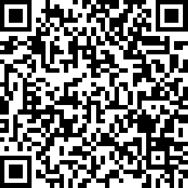
Feedback Survey:
Let us know how we did!
Scan this QR code or visit the link
and fill out this quick survey
surveymonkey.com/r/SIRCEvaluation
Notes:
Update Code if needed

